Slide 1
Lane Detection using CARLA simulator
Makhmud Kamolov

Slide 2
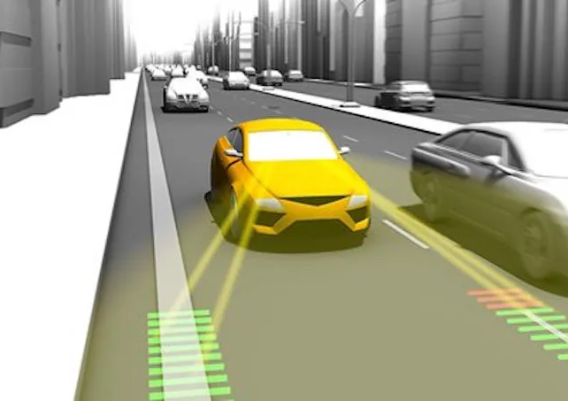
Why Lane Detection?
Lane detection is a fundamental requirement for ADAS functions such as Lane Keeping Assist (LKA), Lane Departure Warning (LDW) and Path Planning. Reliable lane information is essential for maintaining vehicle stability, safety,and accurate lateral control.

Slide 3
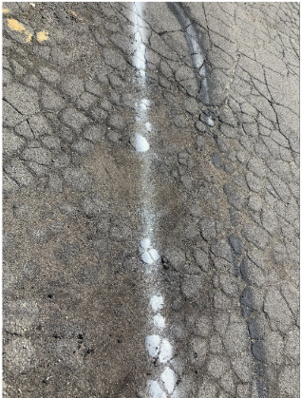
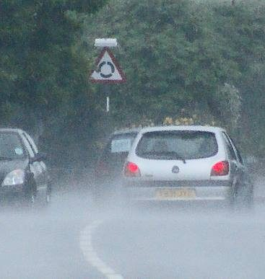
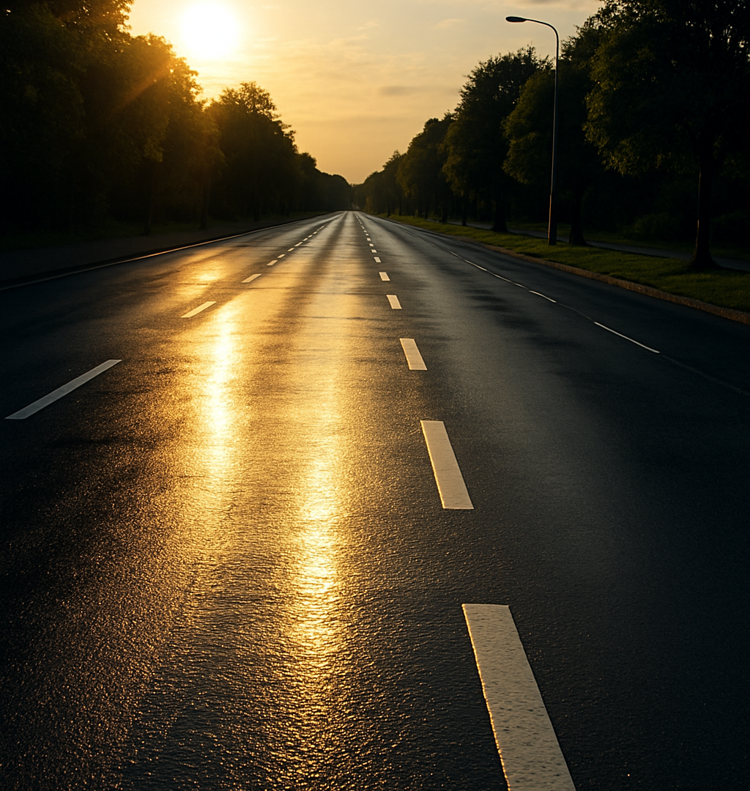
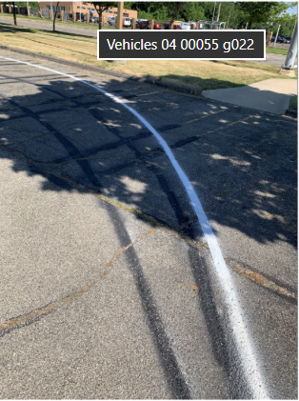
Limitations of Traditional Methods
Classical computer vision (Canny edge detection, Hough transform, color thresholds)often fails under:
shadows, sunlight reflections
worn-out or missing lane markings
rain, fog, night scenes
complex intersections

Slide 4
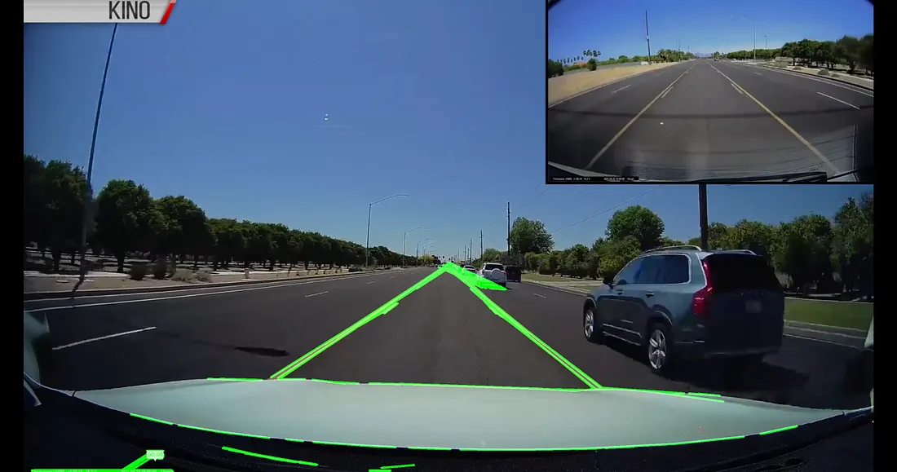
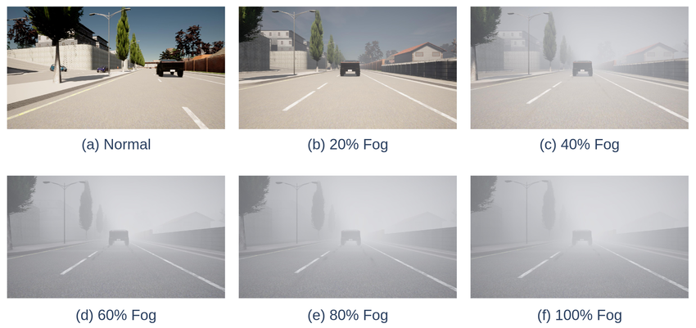
Why YOLO with CARLA?
YOLO provides real-time, high-accuracy object detection suitable for autonomous driving.
CARLA Simulator allows generating large, diverse, labeled datasets without expensive real-world data collection.
Synthetic data helps test lane detection under varied weather, lighting, and road types,improving model robustness.

Slide 5
Downloads
What do we need on table:
Downloading and unarchiving Carla 0.9.16(UE4)
Installing Python v3.12
Installing Pycharm IDE

Slide 6
Setting up the environment
We need to run below codes on Powershell
Creating python environment inside project: python3 -m venv venv-carla
Changing interpreter to venv-carla: Settings -> Interpreter -> Add Interpreter -> Add Local Interpreter -> Select existing -> Python path: C:\Users\kamol\PycharmProjects\Yolo Lane detection\venv-carla\Scripts\python.exe
Upgrading pip: python.exe -m pip install --upgrade pip
Activating the environment: venv-carla\Scripts\activate
Installing Carla Python API to that venv: pip install "C:\Users\kamol\OneDrive\Documents\for carla\PythonAPI\carla\dist\carla-0.9.16-cp312-cp312-win_amd64.whl"
Some basic packages: pip install numpy opencv-python

Slide 7
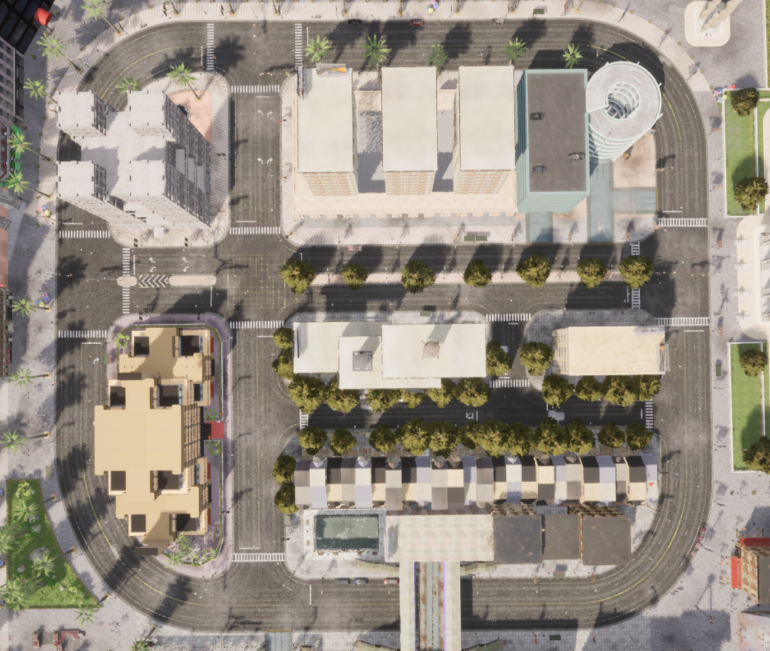
CARLA World Setup
We need to set up Carla:
Carla is started at 20FPS, low quality mode, in Town01
Synchronous mode is enabled: settings.synchronous_mode = True
Fixed time stamp is given: settings.fixed_delta_seconds = 0.05
Traffic manager is set up: tm = client.get_trafficmanager(8000)
Sprawned 50 random vehicles: world.try_spawn_actor(random.choice(vehicle_blueprints), random.choice(spawn_points))
Sprawned ego vehicle: ego_bp = blueprint_library.find('vehicle.lincoln.mkz_2020’) / ego_bp.set_attribute('role_name', 'hero')

Slide 8
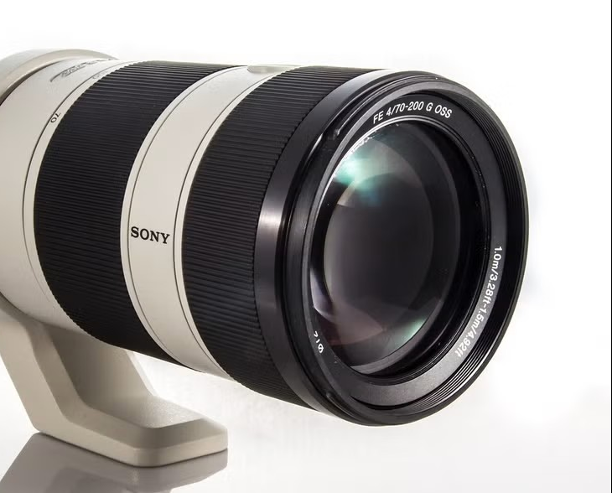
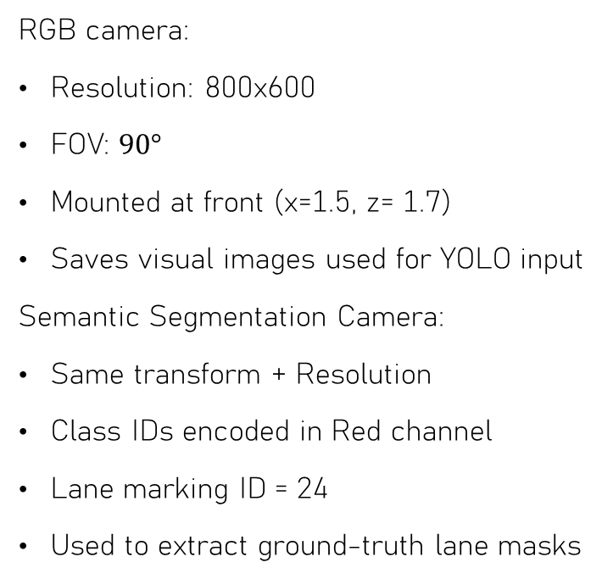
Sensor Confugiration
RGB camera:
Resolution: 800x600
FOV: $90°$
Mounted at front (x=1.5, z= 1.7)
Saves visual images used for YOLO input
Semantic Segmentation Camera:
Same transform + Resolution
Class IDs encoded in Red channel
Lane marking ID = 24
Used to extract ground-truth lane masks

Slide 9

Synchronising Sensors
We need to make sure that both RGB and Segmentation cameras should catch exact frame in each world tick. To do this we should implement couple lines of code:
Using Queues to synchronise callbacks:
camera_rgb.listen(rgb_queue.put)
cam_seg.listen(segm_queue.put)
After each world.tick() we need to do:
rgb_image = rgb_queue.get()
seg_image = segm_queue.get()

Slide 10
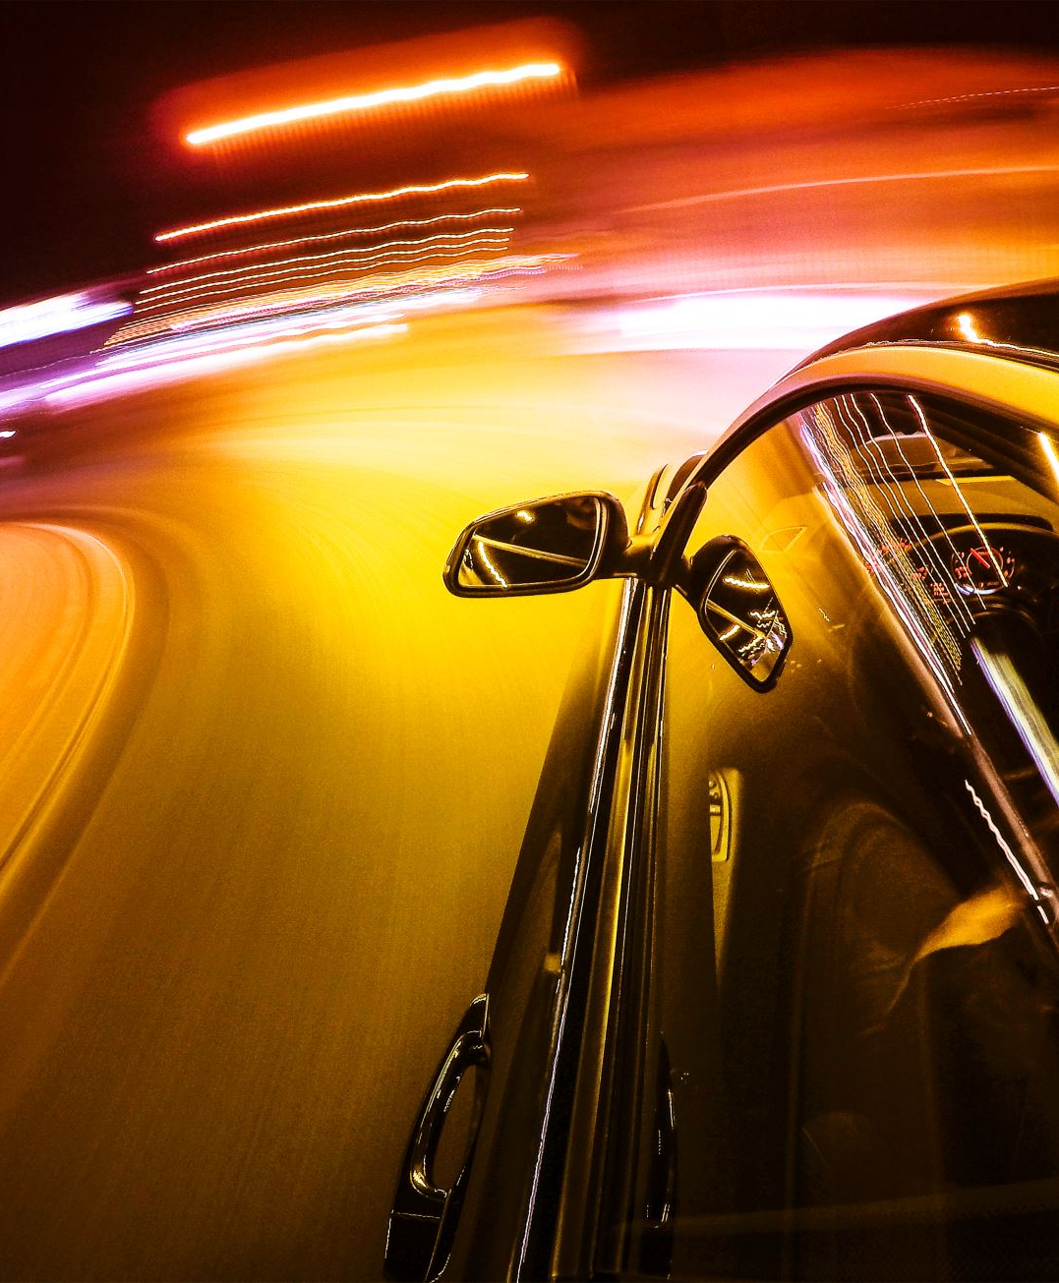
Filtering by Vehicle Speed
When car is not moving, Carla still creates images. To deal with it, applying filtering images by vehicle speed is good option. If vehicle speed is lower than 1km/h, image generation should be stopped. It means avoiding duplicate images at traffic lights or stops: Getting speed: vel = ego_vehicle.get_velocity() Converting it into one speed vector: speed_ms = math.sqrt(vel.x ** 2 + vel.y ** 2 + vel.z ** 2) Converting to km/h: speed_kmh = speed_ms * 3.6 checking: if speed_kmh < MIN_SPEED_KMH: It is used to pass this cycle: continue

Slide 11
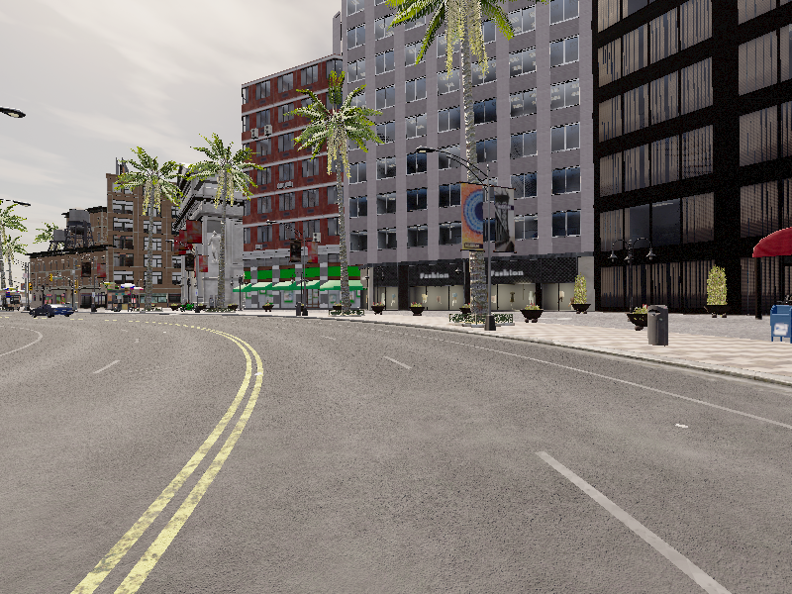
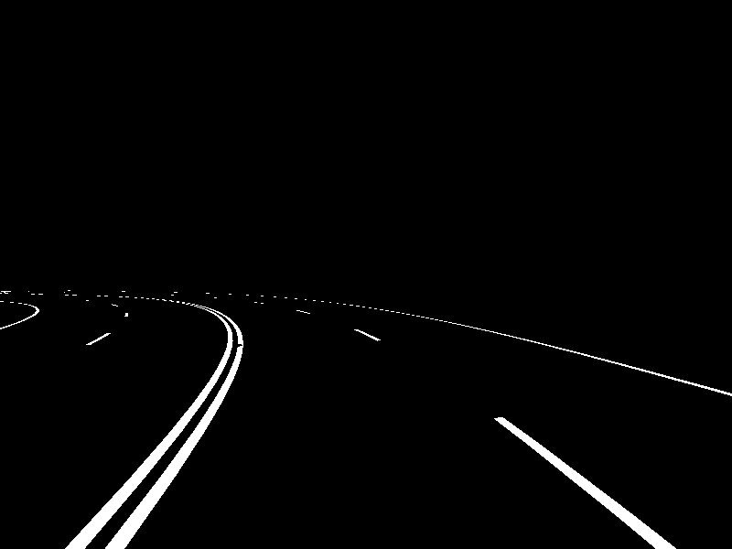
Creating the Dataset (RGB + Masks)
Every 20 frames, 1 image pairs (RGB and segmentation camera) will be saved to specific folder.
When saving file names should be matched. It makes it easier to create labels for each photos.
dataset/rgb/T2s23.png
dataset/seg/T2s23.png

Slide 12
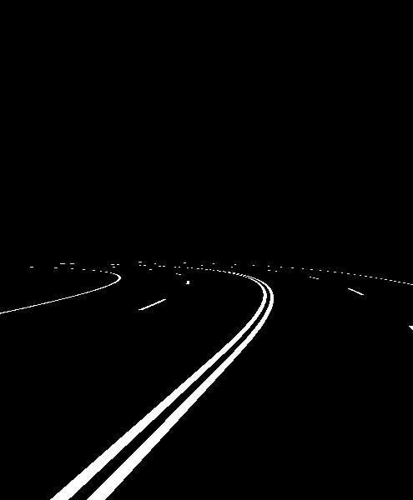
Extracting Lane Masks from Segmentation Camera
Carla encodes semantic class ID in Red channel of BGRA. So, In order to get class id and create mask from it couple of lines are needed:
semantic_map = img_array[:, :, 2]
lane_id = 24
lane_mask = (semantic_map == lane_id)*255
Output is a binary mask. White will be line, black will be all others.

Slide 13
Automatic YOLO Label Generation
Yolo just do not get any data from masks. So, it should be converted to Yolo labels. Pipeline will be in this order:
mask → connected components → bounding boxes → YOLO label file
First of all, mask is converted to binary. Then connected lane segments should be detected. For each segment, there should be bounding box (x, y, w, h) and it will be converted to yolo normalized format.
0 xc yc w h

Slide 14
YOLO Dataset Structure
The required YOLO folder structure:
dataset/
images/
train/
val/
labels/
train/
val/
There is a train, val split. Training datas are saved in train folder and evaluating datas are saved to val folder.
.yaml file:
path: ./dataset # root dir of dataset train: images/train val: images/val names: 0: lane_marking

Slide 15
Model Training (YOLOv8)
Yolo library should be installed: pip install ultralytics

